Slide 1
High School Students Personality and Music Preference Study
Carla Angulo, Jonah Clough, and Juliana Guerra

Slide 2
Research Questions
RQ1: Is there an association between introversion/extroversion personality type and preferred music genre among high school students?
Ho= Music preference and personality type ARE independent
Ha= Music preference and personality type ARE associated
RQ2: Is there a difference in the amount of hours someone listens to music based on their personality type?
Ho= Introverts and extroverts do not differ in the number of hours they listen to music per day
Ha= There IS a difference between the number of hours that introverts and extroverts listen to per day

Slide 3
Literature Review
Rentfrow & gosling (2003) Extroverts prefer energetic, rhythmic music (pop, hip-hop), while introverts prefer complex, reflective music (classical, jazz)
Schafer & Mehlhorn (2017)
Personality traits have consistent but moderate correlations with music preferences but are still impacted by other factors (culture)
North & Hargreaves (2008) Music is shaped by social identity, peers, and culture, not just personality
Our Question: could personality affect the type of music people listen to?

Slide 4
Literature Review
Rossi, Oasi, & Colombo (2024)
Personality affects frequency and intensity of music listening.
Linnemann et al. (2018) and Greb, schlotz, & steffens (2016) Listening depends on personality driven goals Extraverts have longer sessions, social/mood boosting listening Introverts have shorter, focused/reflective listening
Chamorro-Premuzic & Furnham (2007) Personality predicts frequency, duration, and purpose of music use. Our Question: can personality determine how long people listen to music?

Slide 5
Survey Design
High school students were randomly selected from multiple classes.
All classes at Doral Academy were assigned a numerical code from 001 to 149.
A random number generator was used to select four of these class codes, which corresponded to four classrooms where participants would be chosen.
Within each of the four selected classrooms, 13 students were randomly selected based on the classroom phone chart pocket numbers.
A random number generator was used to generate 13 numbers that corresponded to the pocket numbers assigned to students in each class.
A total of 52 participants were shown a QR code with a link to an anonymous Google Forms survey.

Slide 6
Survey Questions
What grade are you in?
9th
10th
11th
12th
Based on the MBTI personality test, do you identify as an extrovert or introvert?
Introvert
Extrovert
How accurate do you think your personality result is?
Very accurate
Somewhat accurate
Not very accurate
Not accurate at all
Please select your result on the MBTI personality test
INTJ
INTP
ENTJ
ENTP
INFJ
INFP
ENFJ
ENFP
ISTJ
ISFJ
ESTJ
ESFJ
ISTP
ISFP
ESTP
ESFP
What is your favorite music genre? (choose one)
Pop
Indie/Alternative
Rap/Hip-hop
Rock
R&B
Country
Electronic
Classical
Reggaeton
House
Other: _______

Slide 7
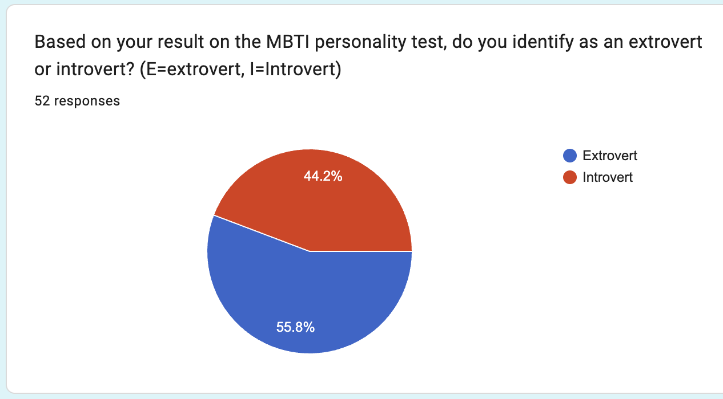
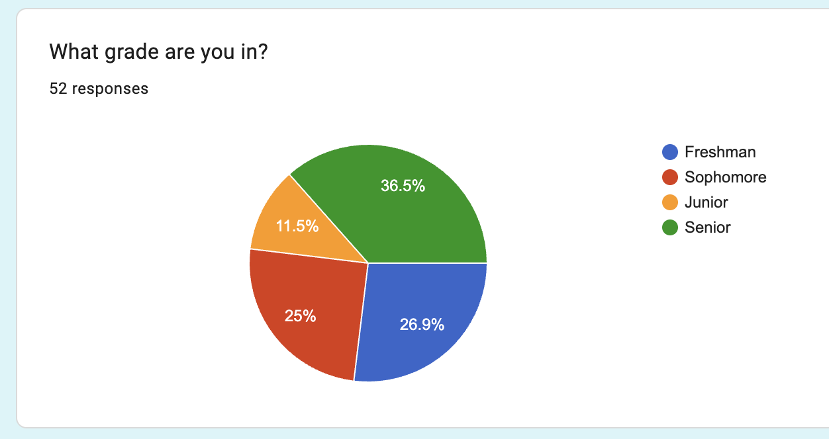
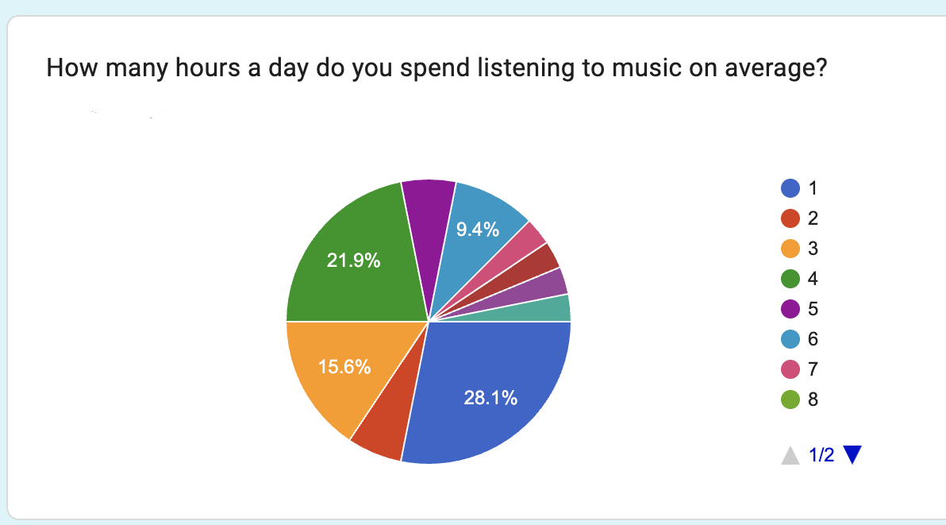
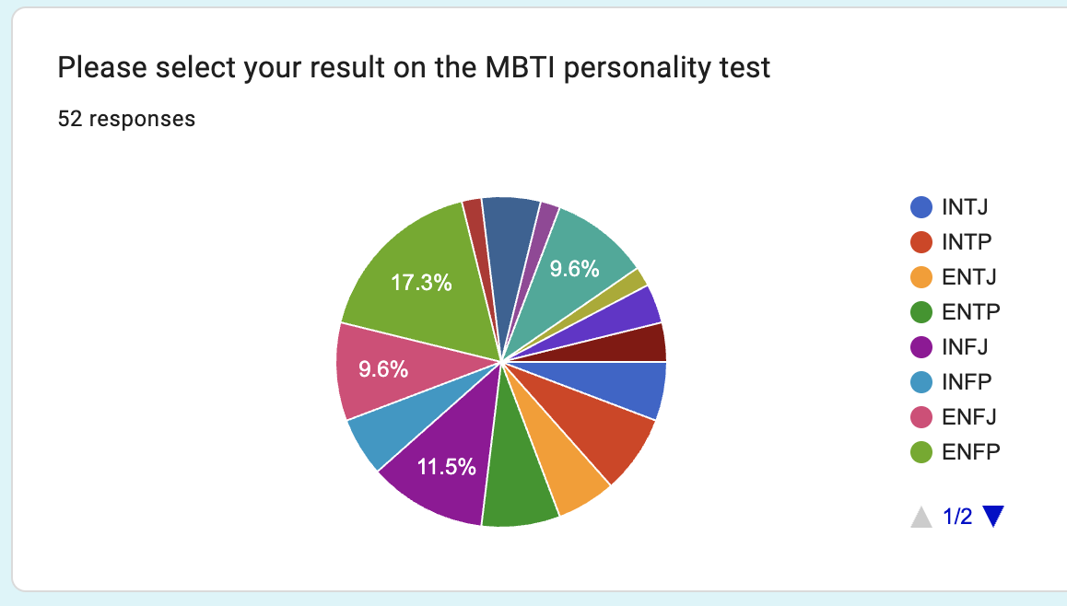
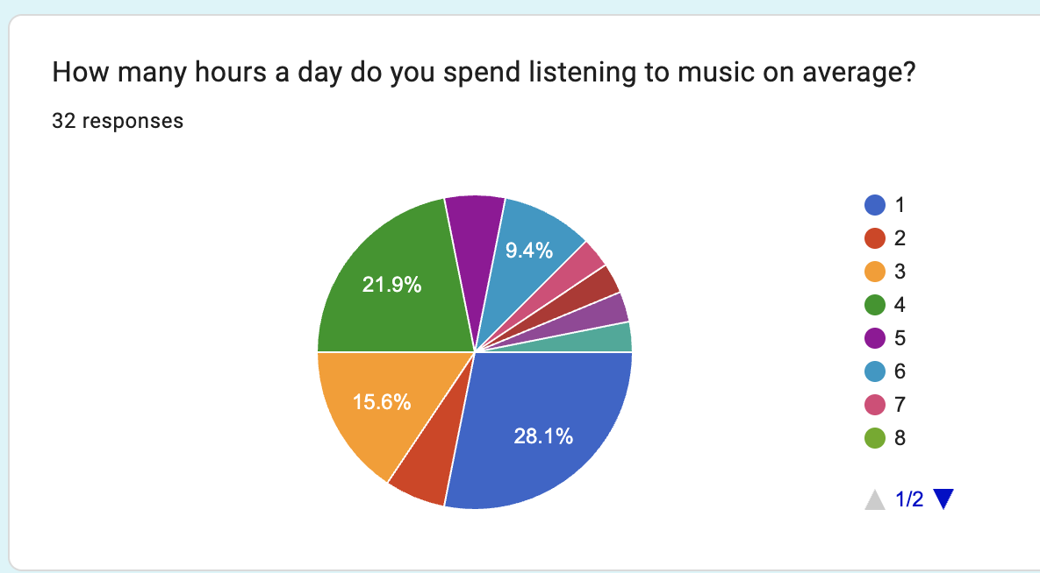
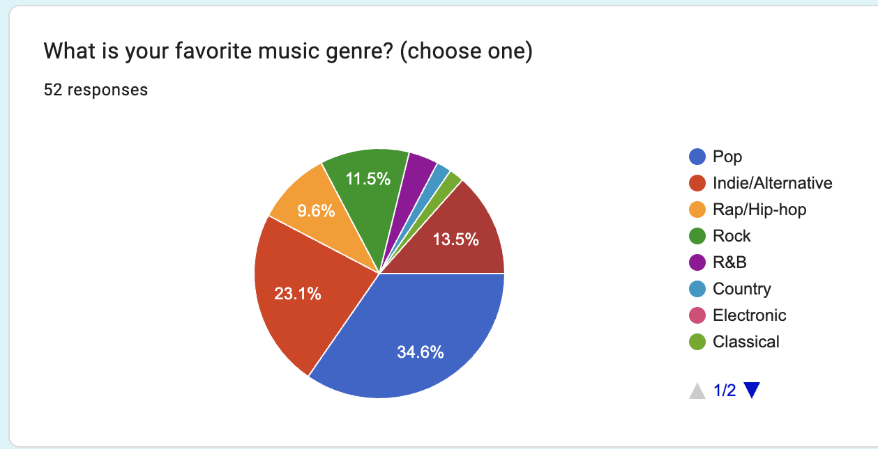
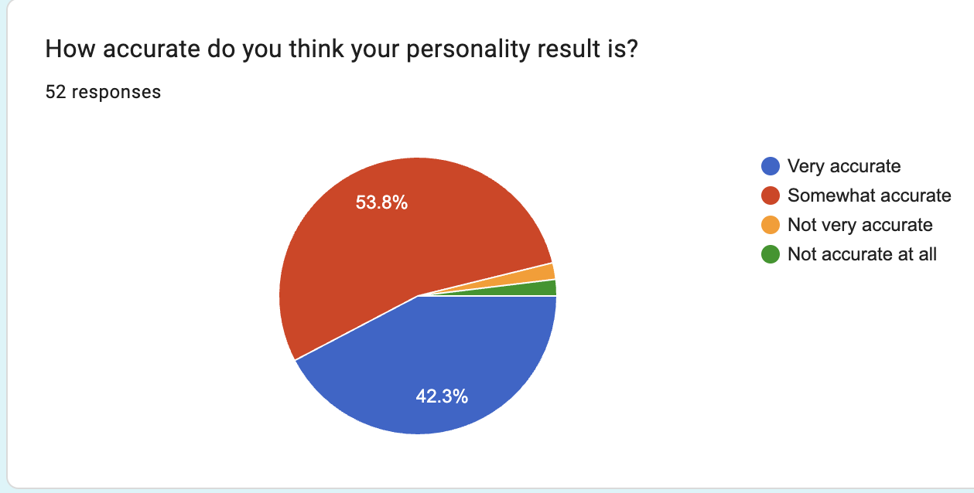
Survey Results

Slide 8
Relationship Between Variables
Examines the relationship between grade level, MBTI personality type, and favorite music genre
Explores how personality and student development may influence music preference
Investigates whether students in different grades or personality categories show different genre preferences
Seeks to identify meaningful patterns among these variables

Slide 9
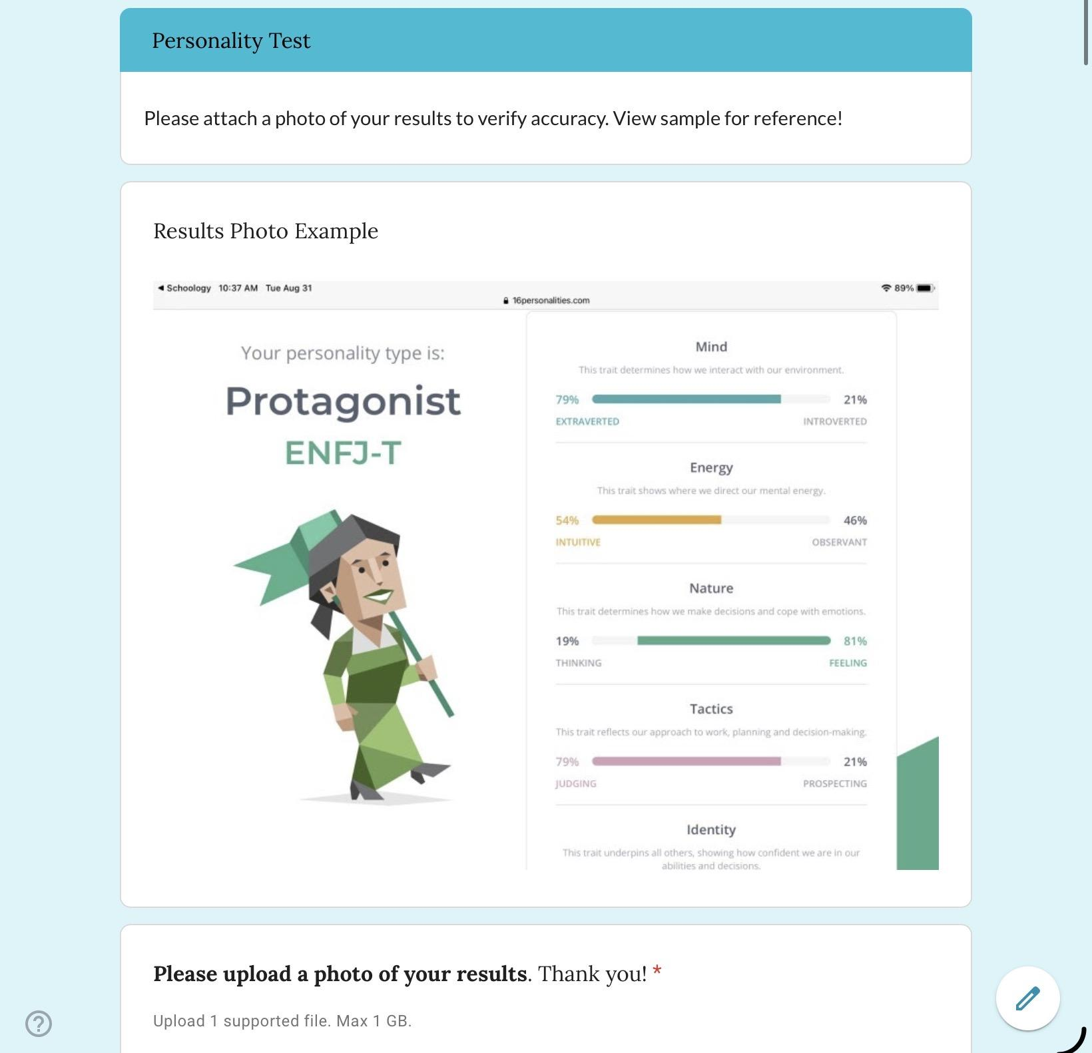
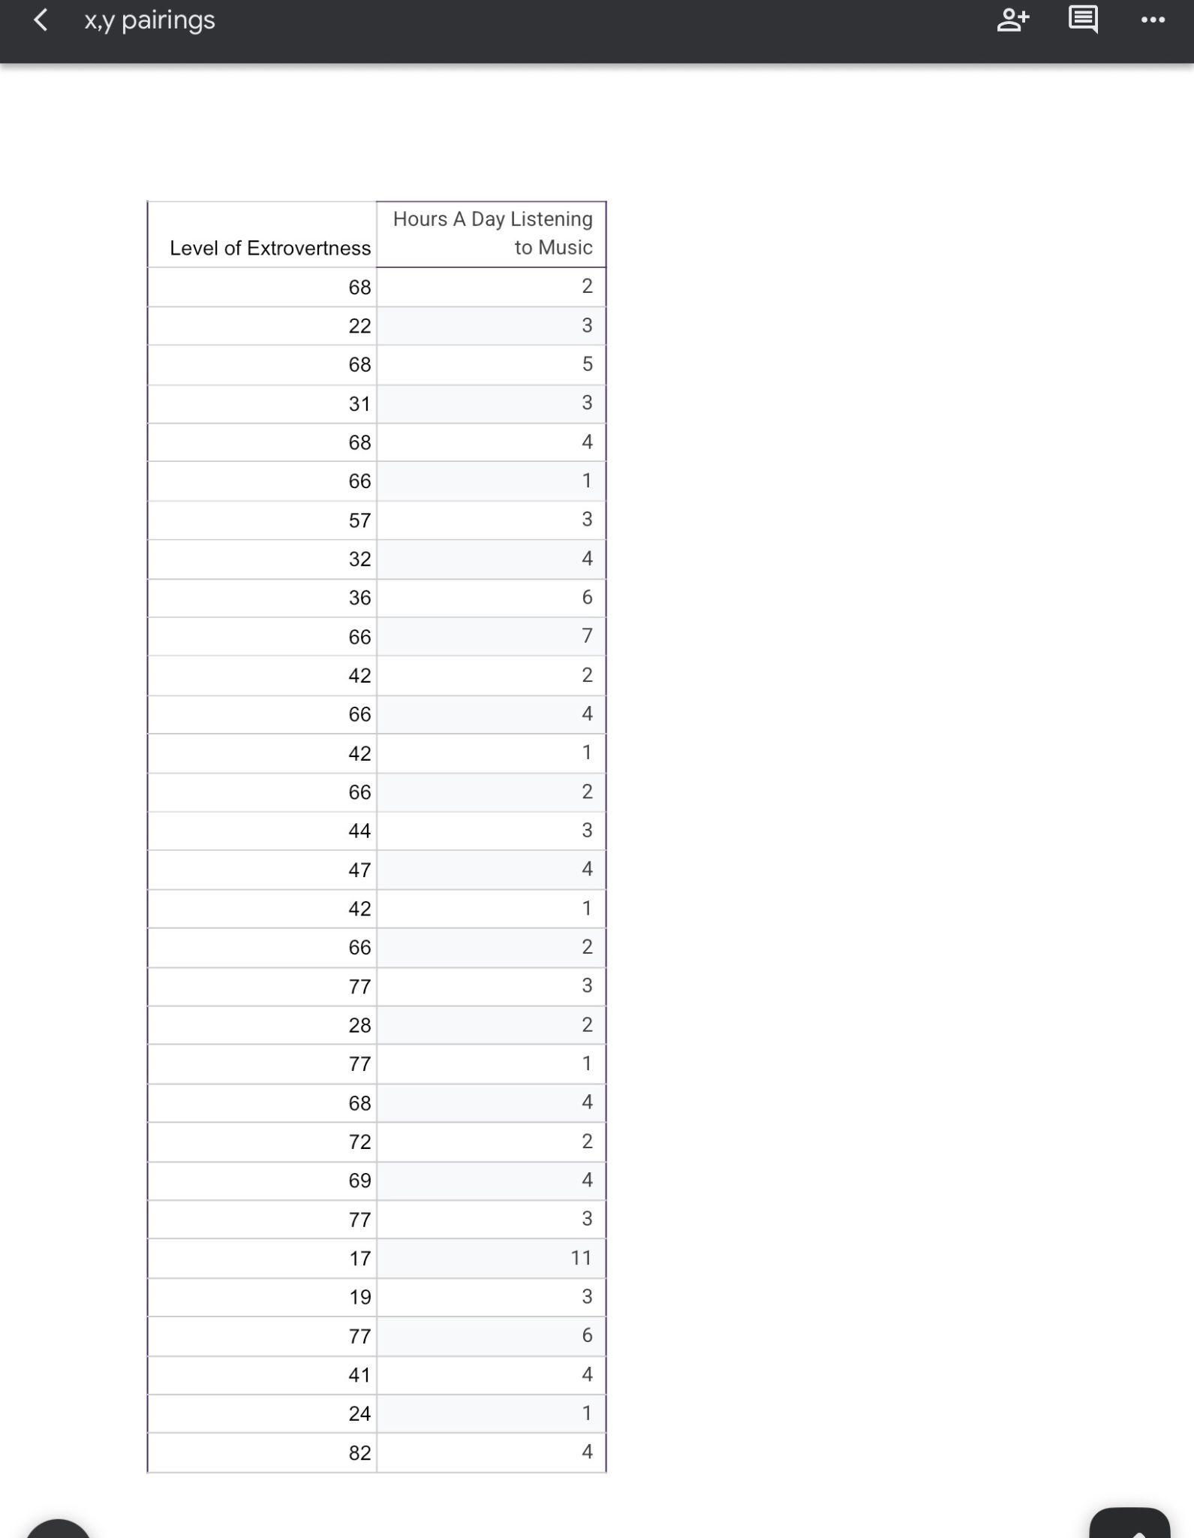
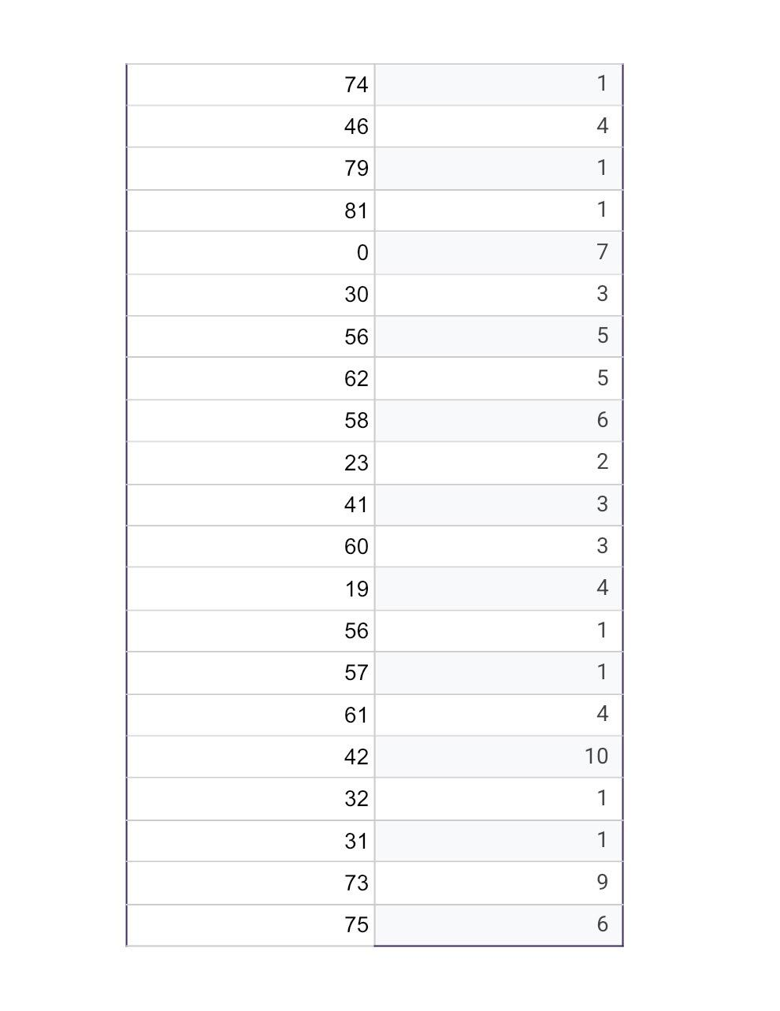
Scatterplot Data

Slide 10
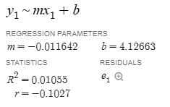
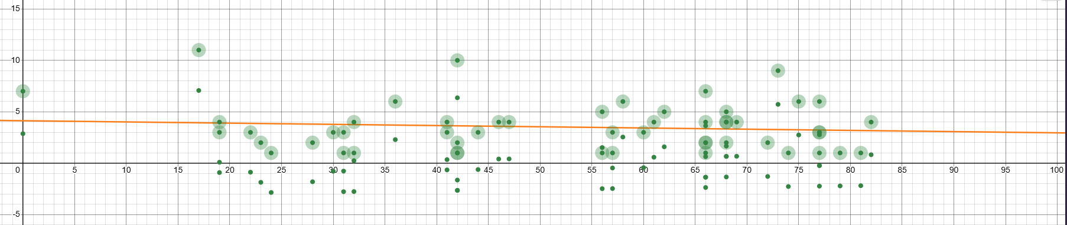
Scatterplot
This can be the part of the presentation where you introduce yourself, write your email or contact data…

Slide 11
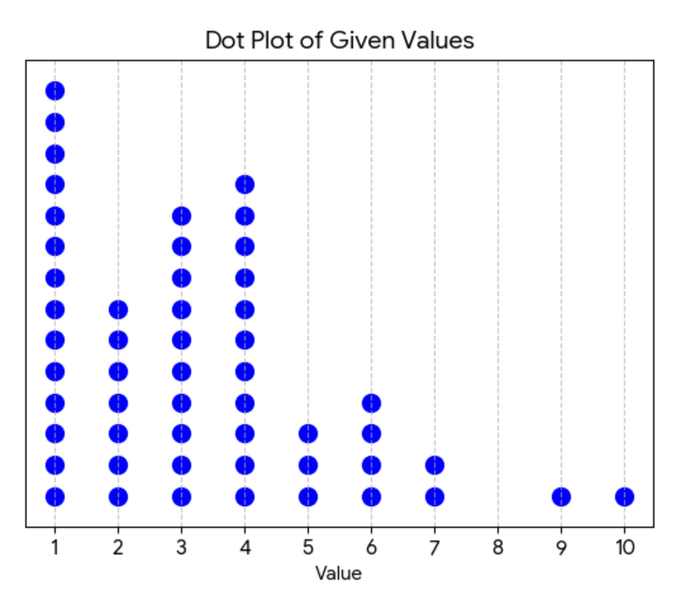
Descriptive Statistics
Mean= 3.52 hours
Standard deviation= approx 2.3 hours
Median= 3 hours
Ranged= 1 to 10 days per hours.
Distribution appears to be skewed to the right

Slide 12
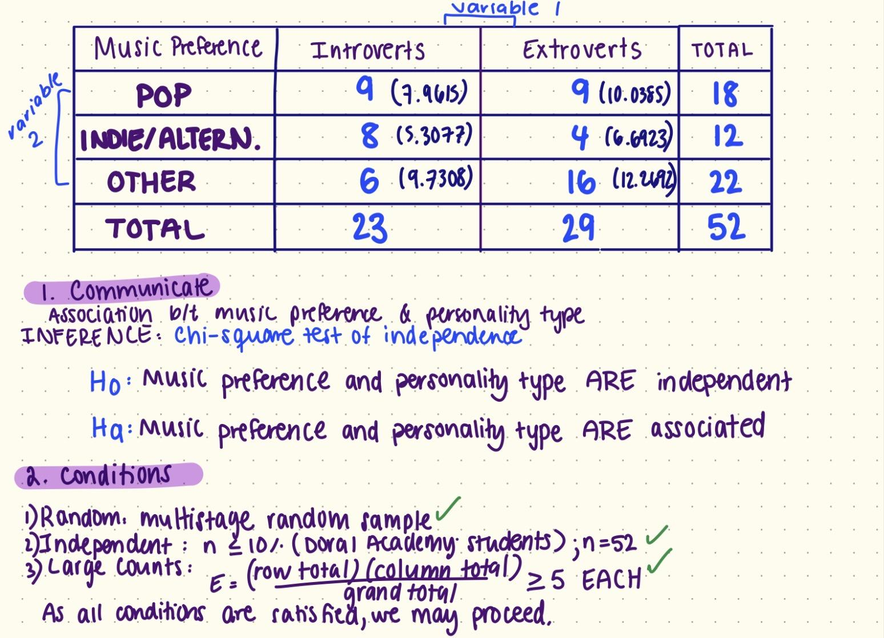
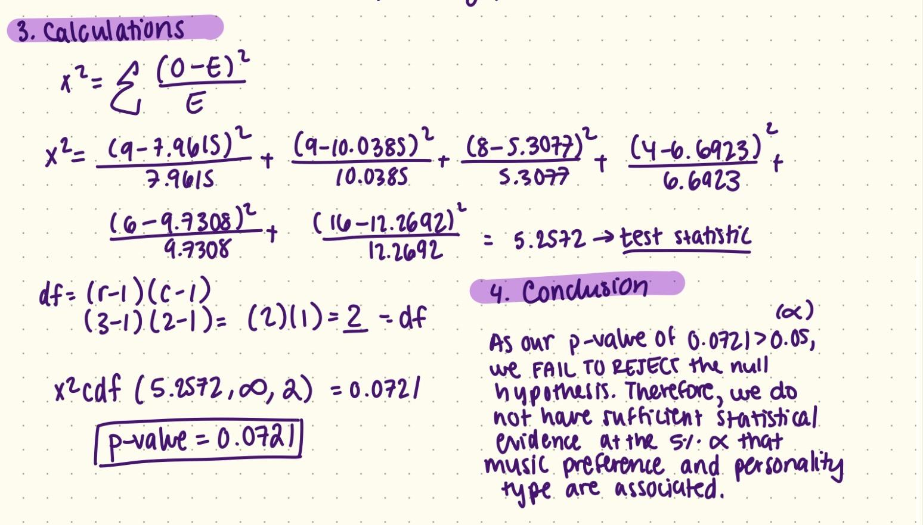
RQ1 Calculations

Slide 13
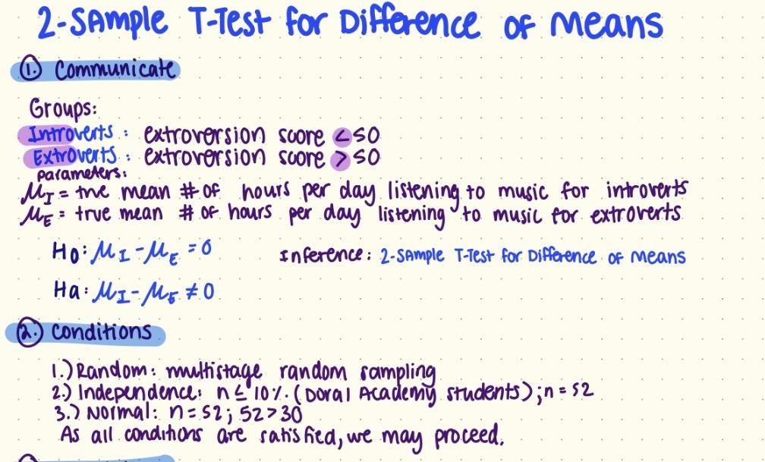
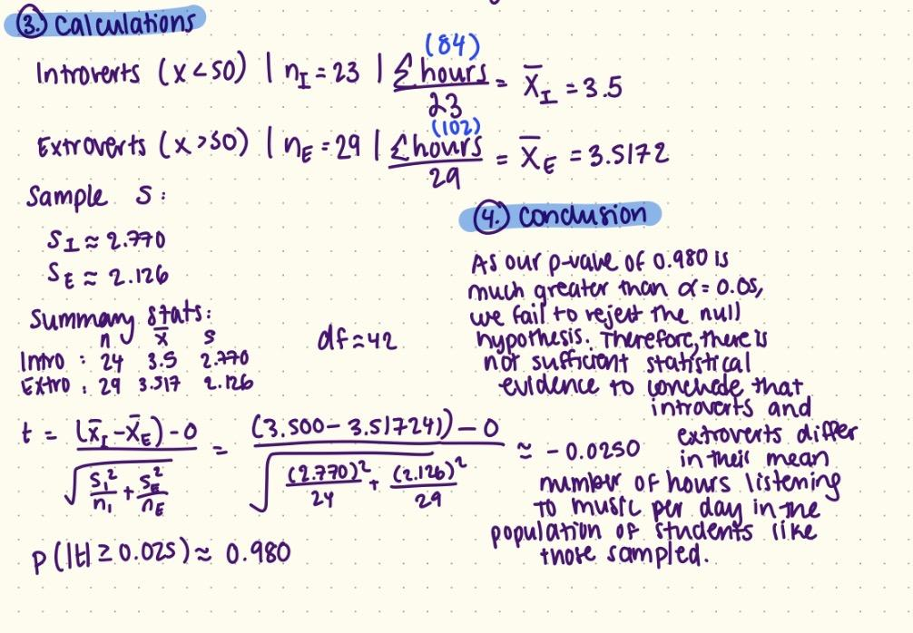
RQ2 Calculations

Slide 14
Conclusion
Contrary to common assumptions that personality type strongly influences music taste, this study did not find a statistically significant association between personality type and music preference among students in the sample. Additionally, the analysis of average hours spent listening to music showed no meaningful difference between introverts and extroverts, suggesting similar listening behaviors across personality classifications.
Students may be influenced more by social environment and cultural trends than by personality alone
Music preference is highly subjective and multifaceted, making it difficult to capture clear patterns with broad genre categories.
The use of MBTI classifications may not fully represent the complexity of personality traits.
Had to reduce the groups for music preference which may have reduced variability
Because this was an observational study, causation cannot be inferred.

Slide 15
Future Directions and Limitations
Expand the study to include multiple schools or age groups for broader generalizability.
Incorporate more detailed or multidimensional personality assessments beyond broad MBTI classifications.
Investigate how factors like culture, peer groups, or mood regulation may influence music preference.
The study relied on self-reported survey data, which may introduce measurement error or response bias.
The study was conducted within one school population, limiting the generalizability of the findings beyond that setting.
MBTI personality classifications may oversimplify personality and may not capture the full complexity of individual traits.

Slide 16
Thank you!

